Slide 1


Slide 2
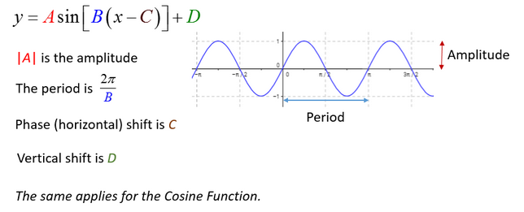

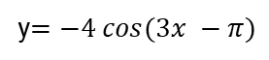
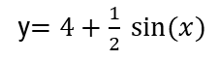
Periodic functions
Amplitude
Period
Phase shift
y$=4+\frac{1}{2} sin⁡(x)$
y$=−4 cos(3x −π)$

Slide 3
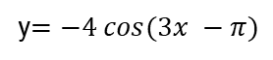
Periodic functions – exercises spyder
y$=4+\frac{1}{2} sin⁡(x)$
Radians degrees samples
y$=−4 cos(3x −π)$
What is the period of these functions?
What is the amplitude?
How many samples (minimum amount ) is needed to see the smoothing charts ?

Slide 4
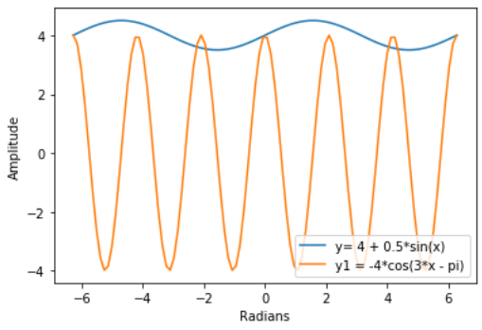
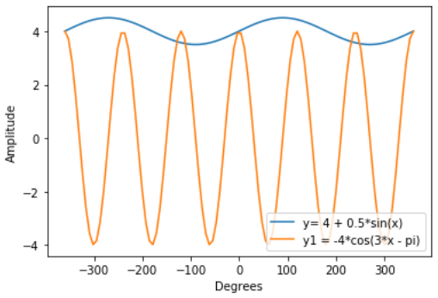
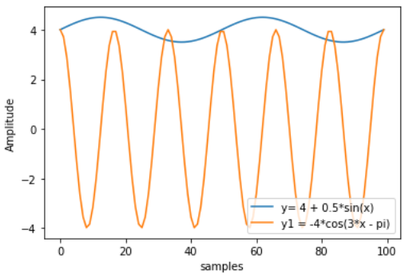
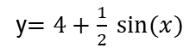
Periodic functions – exercises spyder
Radians degrees
y$=4+\frac{1}{2} sin⁡(x)$
y$=−4 cos(3x −π)$
Samples

Slide 5

<WELCOME >
<Logarithms>

Slide 6
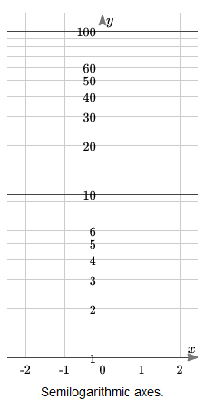
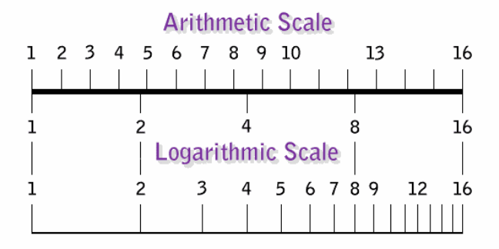
Log scale

Slide 7
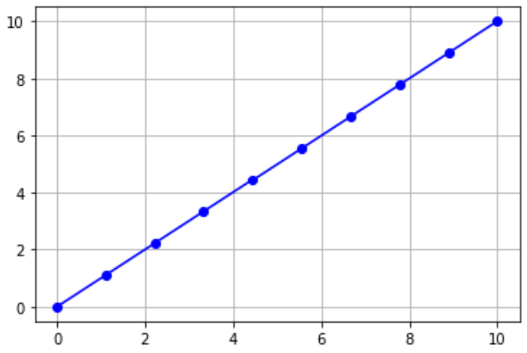
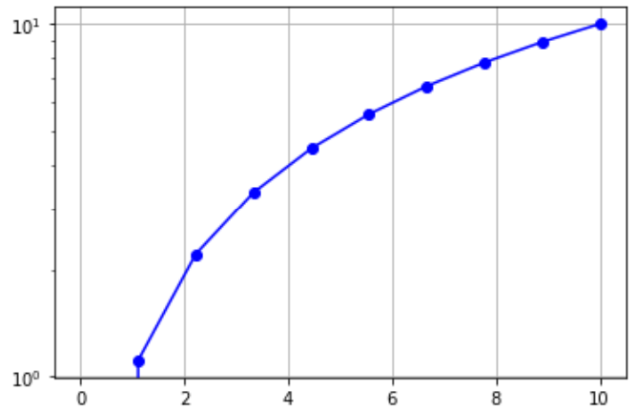
y = x
y = x
y = x
import numpy as np
x = np.linspace(0,10,10)
y = x
plt.plot(x, y)
plt.semilogy()
plt.grid()
import numpy as np
x = np.linspace(0,10,10)
y = x
plt.plot(x, y)
plt.grid()
Same function

Slide 8
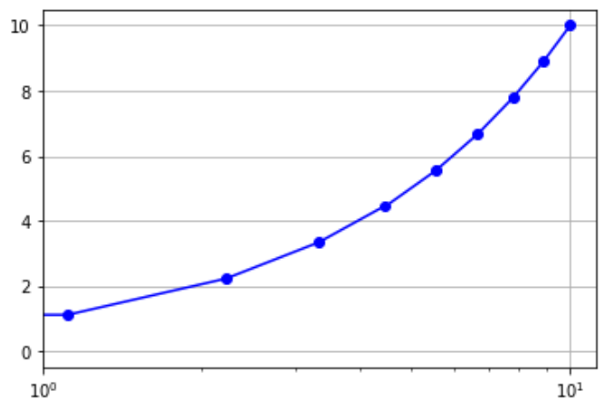
y = x
y = x
import numpy as np
x = np.linspace(0,10,10)
y = x
plt.plot(x, y)
plt.semilogx()
plt.grid()
import numpy as np
x = np.linspace(0,10,10)
y = x
plt.plot(x, y)
plt.grid()
Same function

Slide 9
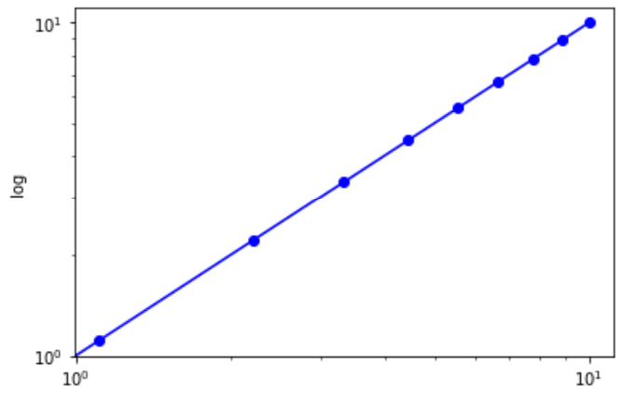
y = x
y = x
import numpy as np
x = np.linspace(0,10,10)
y = x
plt.plot(x, y)
plt.grid()
import numpy as np
x = np.linspace(0,10,10)
y = x
plt.yscale('log')
plt. xscale('log')
plt.grid()
Same function

Slide 10
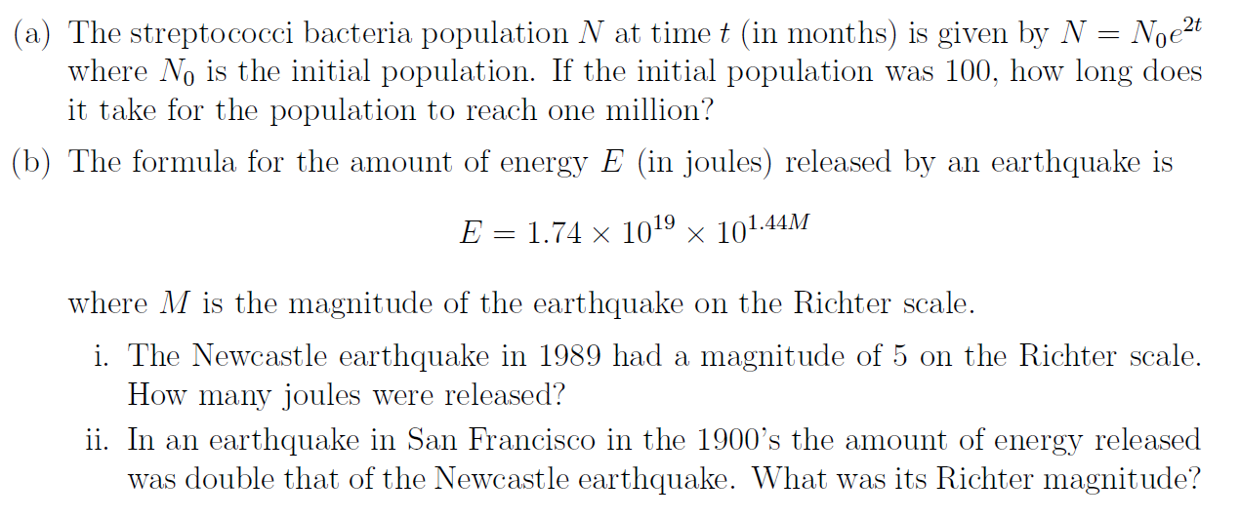
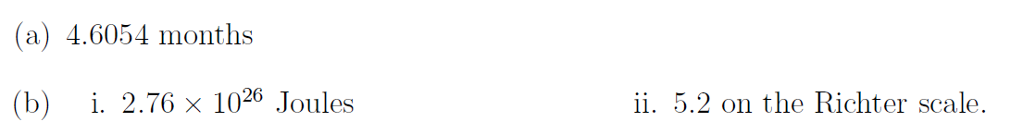
Exercises
Plot the function using linear scale and log scale and tell what is the best way to understand the what is happening with the data

Slide 11

How to find the A and n in the function
$$y=Ax^{n}$$
We change y to loglog scale so we could find A and n easily
Log(y)
n
1
A
Log(x)

Slide 12
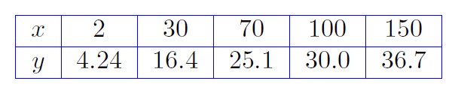
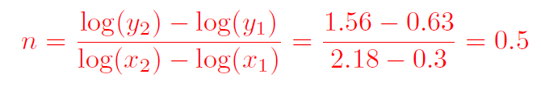
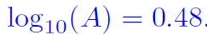
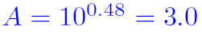
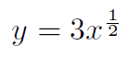
Consider the data
import matplotlib.pyplot as plt
import numpy as np
x = [2, 30, 70, 100, 150]
y = [4.24, 16.4, 25.1, 30.0, 36.7]
logx = np.log10(x)
logy = np.log10(y)
print(np.poly1d(np.polyfit(logx, logy, 1)))
plt.plot(logx,logy, 'o')

Slide 13
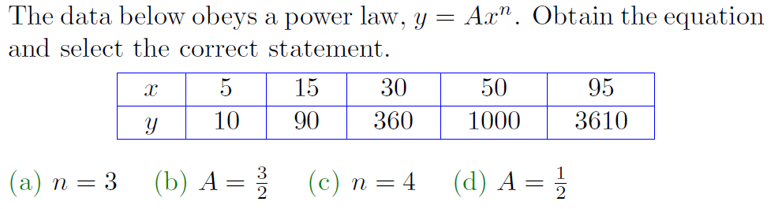
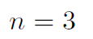
Exercises

Slide 14
<WELCOME >
<Statistics>

Slide 15
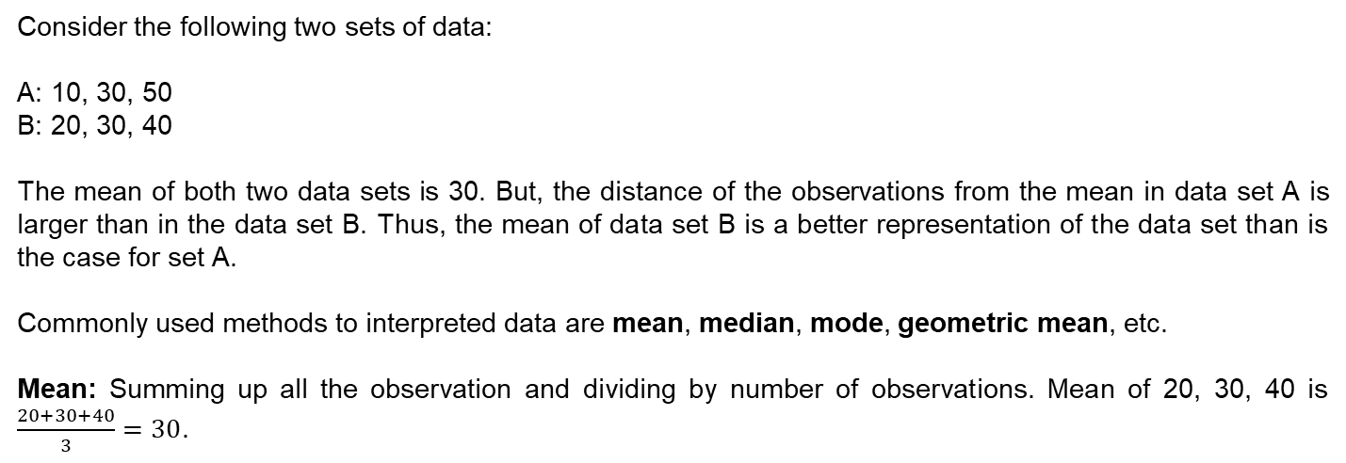
Statistics
Consider the following two sets of data:
A: 10, 30, 50
B: 20, 30, 40
The mean of both two data sets is 30. But, the distance of the observations from the mean in data set A is larger than in the data set B. Thus, the mean of data set B is a better representation of the data set than is the case for set A.
Commonly used methods to interpreted data are mean, median, mode, geometric mean, etc.
Mean: Summing up all the observation and dividing by number of observations. Mean of 20, 30, 40 is $\frac{20+30+40}{3}=30$.

Slide 16
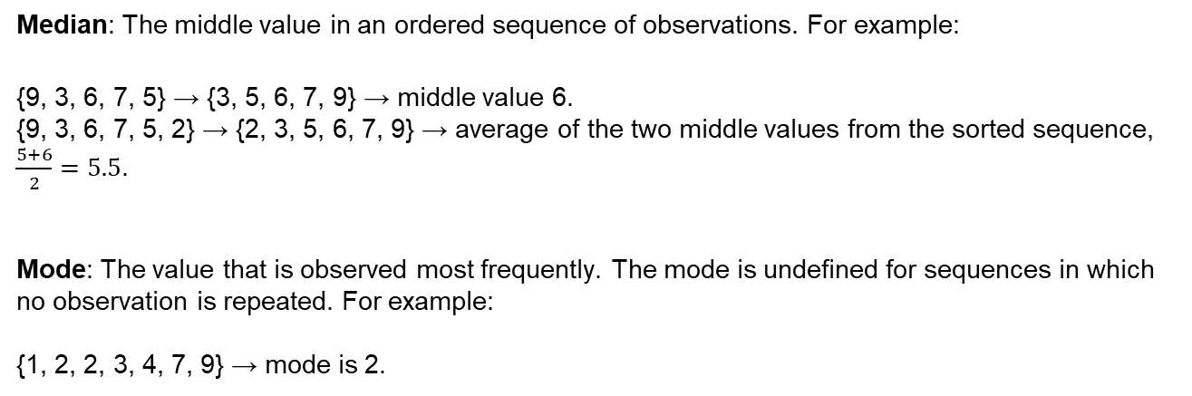
Statistics
Median: The middle value in an ordered sequence of observations. For example:
{9, 3, 6, 7, 5} → {3, 5, 6, 7, 9} → middle value 6.
{9, 3, 6, 7, 5, 2} → {2, 3, 5, 6, 7, 9} → average of the two middle values from the sorted sequence, $\frac{5+6}{2}=5.5$.
Mode: The value that is observed most frequently. The mode is undefined for sequences in which no observation is repeated. For example:
{1, 2, 2, 3, 4, 7, 9} → mode is 2.

Slide 17

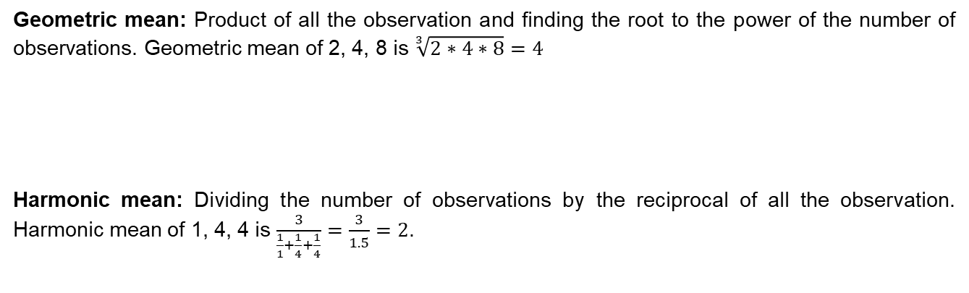
Mean: Summing up all the observation and dividing by number of observations. Mean of 20, 30, 40 is $\frac{20+30+40}{3}=30$.
Statistics
Geometric mean: Product of all the observation and finding the root to the power of the number of observations. Geometric mean of 2, 4, 8 is $\sqrt[3]{2∗4∗8}=4$
Harmonic mean: Dividing the number of observations by the reciprocal of all the observation. Harmonic mean of 1, 4, 4 is $\frac{3}{\frac{1}{1}+\frac{1}{4}+\frac{1}{4}}=\frac{3}{1.5}=2$.

Slide 18
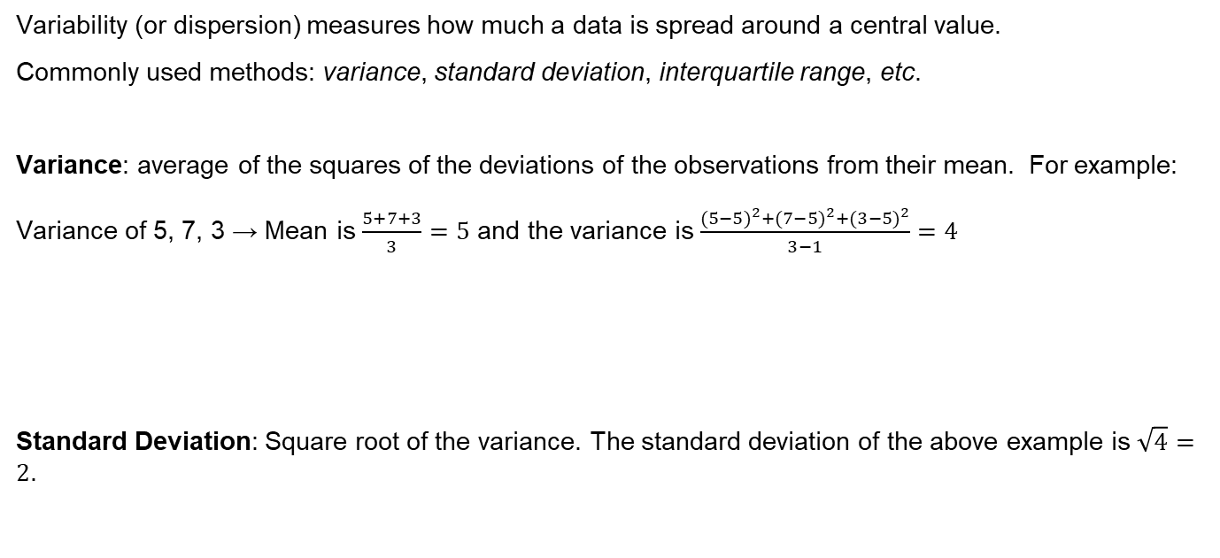
Statistics
Variability (or dispersion) measures how much a data is spread around a central value.
Commonly used methods: variance, standard deviation, interquartile range, etc.
Variance: average of the squares of the deviations of the observations from their mean. For example:
Variance of 5, 7, 3 → Mean is $\frac{5+7+3}{3}=5$ and the variance is $\frac{{(5−5)}^{2}+{(7−5)}^{2}+{(3−5)}^{2}}{3−1}=4$
Standard Deviation: Square root of the variance. The standard deviation of the above example is $\sqrt{4}=2$.

Slide 19
Sampling, Quartile
Statistics
Quartile: Division of the data in four regions that cover the total range of observed values. In other words, the first quartile (Q1) is the first 25% of the data. The second quartile (Q2) is from 25% to 50% of the data. The third quartile (Q3) is from 50% to 75% of the data. For example:
Consider the data: {3, 6, 7, 11, 13, 22, 30, 40, 44, 50, 52, 61, 68, 80, 94}
Divide the data in 4 equal groups. In this case, the group consists of 4 elements:
{3, 6, 7, 11, 13, 22, 30, 40, 44, 50, 52, 61, 68, 80, 94}
The first quartile is Q1 = 11. The second quartile is Q2 = 40 (this is also the median). The third quartile is Q3 = 61.
Inter-quartile Range: Difference between Q3 and Q1. Considering the last case, 61 – 40 = 21.
Q1
Q2
Q3

Slide 20
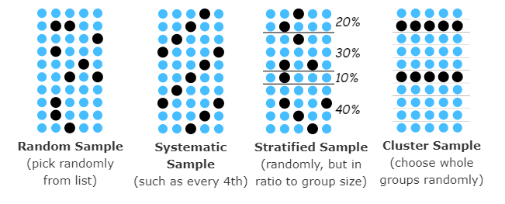
Statistics
Sampling: selection of a subset of individuals from a statistical population to estimate characteristics of the whole population.
Random sample: pick the individuals randomly from the population. It is the best way to avoid bias. The results are better when you pick more individuals. For example, nationwide opinion polls survey around 2000 people, and the results are nearly as good (within about 1%) as asking everyone.
Systematic sample: select individual following a specific rule such as picking an individual every 4th.
mathsisfun.com/data/sampling

Slide 21
Statistics
Sampling: selection of a subset of individuals from a statistical population to estimate characteristics of the whole population.
Stratified sample: divide the individuals in specific categories and pick them according to its proportional in the sample. For example, pick 7 students in a 100 group of people from the city because there are 7% of students in the city.
Cluster sample: divide the individuals in many groups and select randomly whole groups. For example, divide the city in regions and pick randomly 3 regions to survey everyone there.
mathsisfun.com/data/sampling

Slide 22
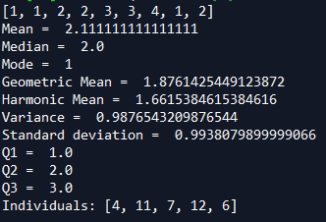
Statistics - Python
import numpy as np
from scipy import stats
from scipy.stats import gmean
from scipy.stats import hmean
import random
numbers = [ 1, 1, 2, 2, 3, 3, 4, 1, 2 ]
print(numbers)
Mean = np.mean(numbers)
Median = np.median(numbers)
Mode = int(stats.mode(numbers)[0]) # index 1 gives frequency
print("Mean = ", Mean, "\nMedian = ", Median, "\nMode = ", Mode)
Geometric_Mean = gmean(numbers)
Harmonic_mean = hmean(numbers)
print("Geometric Mean = ", Geometric_Mean, "\nHarmonic Mean = ", Harmonic_mean)
Variance = np.var(numbers)
Standard_Deviation = np.std(numbers)
print("Variance = ", Variance, "\nStandard deviation = ", Standard_Deviation)
Q1 = np.percentile(numbers, 25)
Q2 = np.percentile(numbers, 50)
Q3 = np.percentile(numbers, 75)
print("Q1 = ", Q1, "\nQ2 = ", Q2, "\nQ3 = ", Q3) # 1 1 1 2 2 2 3 3 4
Sample = [1, 2, 3, 4, 5, 6, 7, 8, 9, 10, 11, 12]
print("With list:", random.sample(Sample, 5))
Output:

Slide 23
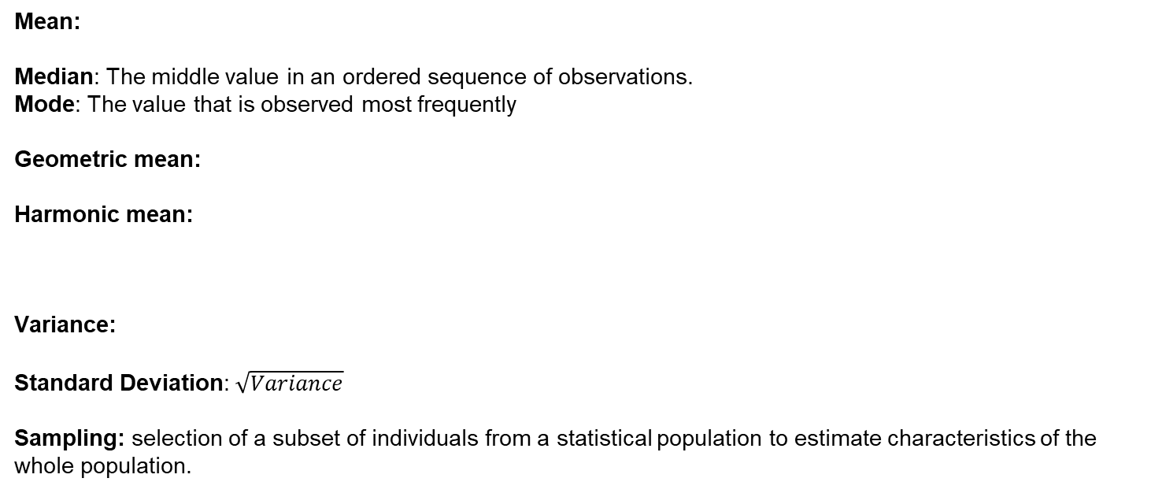
Statistics - review
Mean:
Median: The middle value in an ordered sequence of observations.
Mode: The value that is observed most frequently
Geometric mean:
Harmonic mean:
Variance:
Standard Deviation: $\sqrt{Variance}$
Sampling: selection of a subset of individuals from a statistical population to estimate characteristics of the whole population.

Slide 24
Make it work
Make it Right
Make it Fast

Slide 25


